Slide 1
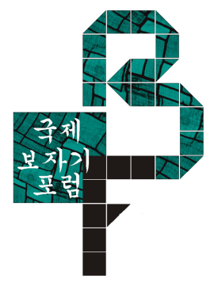
KBF
2012
2014
2016
2018
KOREA BOJAGI FORUM

Slide 2
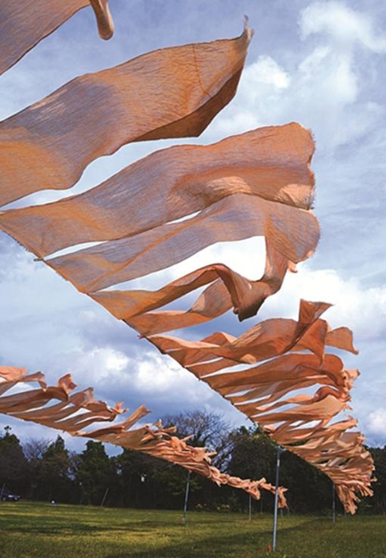
CONTENTS
History of Korea Bojagi Forum(KBF)
> Purpose
> Introduction to General Planner
> 2012 KBF Overview, Lectures, Exhibitions, Workshops
> 2014 KBF Overview, Lectures, Exhibitions and linked Events
_ 2014 KBF and After Events
_ 2014 Gumi Bojagi Special Artists Exhibition
_ 2015 Korea/Romania 25th Anniversary of
Diplomatic Relations Special Exhibition
_ 2015 Hands of Korea-Miami Exhibition
2016 KBF
> Overview and Location
> Event Schedule
> Lecture Theme and Lecturer
> Exhibition Participant Artists and Work Images
> Workshop Program and Instructor Introduction
3. 2018 KBF
> Overview and Location
> Event Schedule
> Exhibition Participant Artists and Work Images
> Workshop/Lecture/Cultural Tour Program and Instructor Introduction
> Post 2018 KBF - Chojun Textile & Quilt Art Museum
> Accomplishment
ⓒ 2014 KBF Part of Jeju Artists’ Village Exhibition

Slide 3
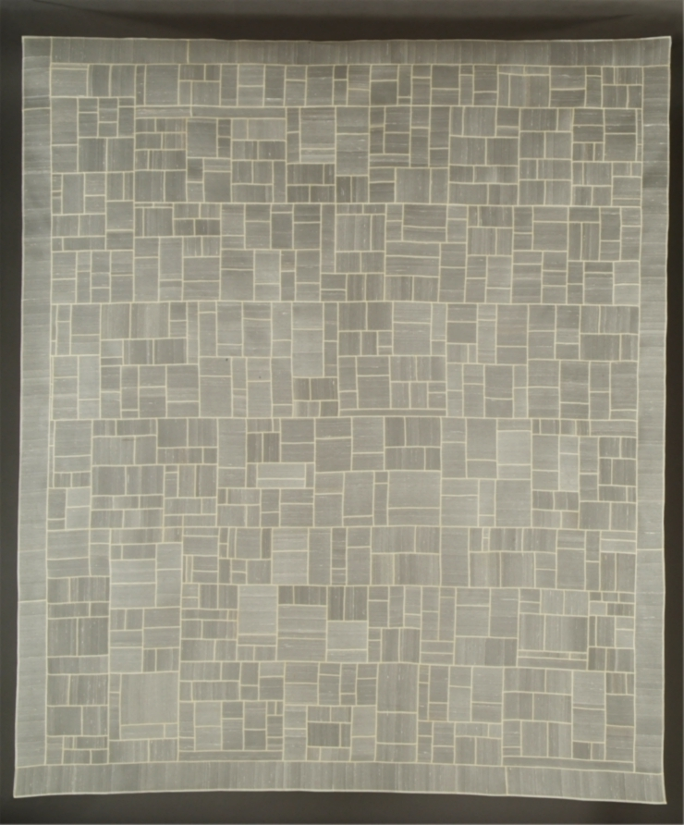
1. KOREA BOJAGI FORUM(KBF)
> Purpose
○ To inform the world about the artistry and excellence of Traditional Korean Bojagi and to seek the direction of development through reinterpretation with contemporary(modern) perspective
○ Contributing to national brand enhancement by developing and research unique design products based on Korean traditional culture
○ Formation of network of domestic and foreign artists centered on Korea through Bojagi
○ Opportunity to experience various contemporary artistic aspects of creative contemporary traditional crafts (overseas artist exhibitions, lectures, workshops, tours, etc.)
○ Promoting Korean native culture and modern Korean textile art
ⓒ 국제보자기포럼작가_이소라 작_호놀룰루_하와이박물관 영구소장

Slide 4
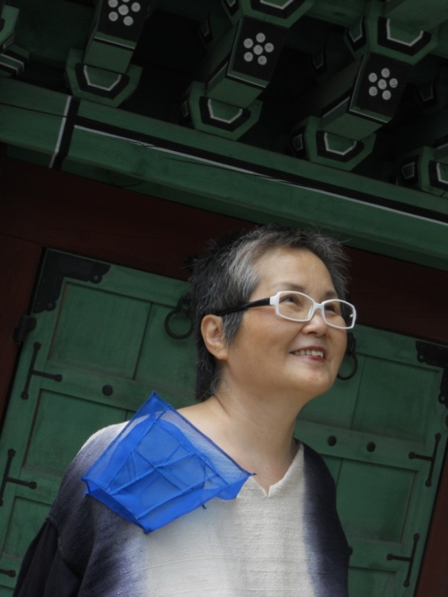
1. KOREA BOJAGI FORUM(KBF)
> General Planner
International Exhibition Planner (France EPM Korea guest-country of honor and others), Textile Artist, International Lecturer
[Education] Graduated from Hongik University and Graduate School
[Career] US Govt Fulbright Grant Rhode Island School of Design Exchange Professor
Instructor of Hongik University (1988-1998)
Full-Time Instructor of University of Art and Design 애비택, Finland
1999-2017 US Rhode Island School of Design (RISD) College of Art
Textile Design, Painting Visiting Professor
Adviser
Korean Artists’ Village Heyri Art Factory, Cheongju International Craft Biennale
Gwangju International Art Costume Biennale, Daegu International Textile Costume Conference, Monthly Publication ‘Hanok’
Individual Exhibition 18 times (Korea, US, Australia, Taiwan, UK, France, Finland)
International Design Society Invited Speaker
(UK, France, US, Australia, Qatar, Netherlands, Canada, etc.)
Major International Planning Exhibition
San Francisco Craft Folk Museum Exhibition, Wrapping Tradition: Korean Textile Now’
France European Patchwork Meeting 행사중 한국 주빈국 4전시, KBF Biennale General Planning 2012/2014/2016/2018
International Symposium Lectures, Workshops and Screenings
Over 50 times (Korea, USA, UK, Japan, France, Switzerland, Taiwan, Canada etc.)
Book Bojagi & Beyond Ⅰ/Ⅱ, US Beyond & Above Publisher,
‘Needle Art’, 한국 경춘사 외 다수 (www.beyond.above.com)
Public institution Collection:
American Museum of Art & Design, NY/Arthur M. Sackler Museum, Harvard University, MA / Museum of Art, Portland, Oregon/Peabody Essex Museum/American Museum of Natural History, NY/Chase Bank, New York./Jack Lenor Larsen Foundation/Honolulu Academy of Arts, HI/Rhode Island School of Design Museum, RI/Newark Museum of Art, NJ/Fuller Craft Museum, MA/ Art Institute of Chicago Museum, IL(US)/
Victoria & Albert Museum, London(UK)/Evtek Institute of Art & Design,(Finland)/
Korea 성우그룹/Korea Gwangju Biennale Art Museum/Walkerhill Art Center
ⓒ 이정희 (Chunghie Lee) 李貞姬
Seudaemun gu, Donggyo ro, 291, Imgwang apartment, 101- 901 Seoul, Korea
+82 (0)2-2602-6959 010-4333-6959
chunghielee.kbf@gmail.com
https://www.facebook.com/chunghie.lee.3
https://www.facebook.com/beyondbojagi/
P.O. Box # 1033, Providence, RI 02901, U.S.A.,
Cel: +1-703-209-9585

Slide 5
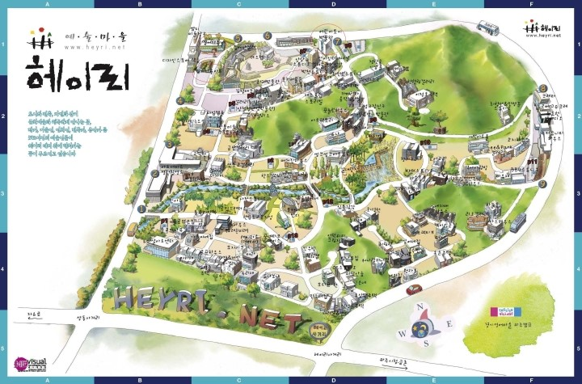
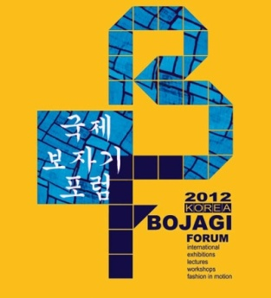
1. KOREA BOJAGI FORUM(KBF)
> 2012 KBF Overview – Six Paju Heyri Artists’ Village Galleries
Date : 2012 Aug 22(Wed) – Aug 25(Sat)
Location : Heyri Community House
Exhibition : Art Factory(Heyri 63-15), Porcelain House Gallery(Heyri 63-23), Art Space(Gwantin sa gil 68, Korea), Nonbat Art School(Heyri 93-45, Korea), Lee&Park Gallery(Heyri 82-136, Korea), Gallery MOA(Heyri48-37, Korea)
Host : Korea Bojagi Forum
Sponsorship : Arts Council Korea, Ministry of Culture, Sports and Tourism, KTO, U.S. Embassy & Consulate in Korea, Korea-American Educational Comminssion, Shuim Museum, National Folk Museum of Korea, The Museum of Korean Embroidery, Culture Arts Sharing, Korea Fiber Art Fair, Quilt Culture Association, Design House, Suwon Cultural Foundation, Suan Art Gallery, Natural Dyeing Museum Mond, Weavingshop, Mokwon University
※ This Project is supported by the Arts Council Korea.

Slide 6
1. KOREA BOJAGI FORUM(KBF) – Six Paju Heyri Artists’ Village Galleries
> 2012 KBF Lectures and Workshops
□ International Invited Lecture
○ Speeches from South Korea, USA, Australia, Finland, Japan and South Africa
○ Keynote Speech : Donghwa Huh, The Museum of Korean Embroidery Director
Youngsoon Kim Hongik University Art Design Education Center Professor and Suan Art Gallery Director
Soonhee Oh, Duksung Women's University Emeritus Professor and ParkEungBuk Embroidery Museum Director
Youngsoon Cha, Ewha Womans University Professor
Jieun Kim, Kyungsung University Professor
Eunsook Lee, 'New Possibilities in Contemporary Plastic Art‘, German Artist
Anais Missakian, US RISD Dean of Fine Art
Kirsi Niinimaki, Aalto University Art and Design Professor, Finland
Jennifer McCabe, Museum of Craft and Folk Art Director
San Francisco, US
Wendy Lugg, Writer, International Speaker, Australia
Hiroko Wadanabe, Tama Art University Emeritus Professor, Japan
Kyungae Cho, University of Wisconsin Professor, US
Jiseon Lee Isbara, Oregon College of Art & Craft Professor
Fiona Kirkwood, South African writer
□ Workshop
Handicraft courses that can be learned only in Korea
Making Bojagi (Handwork: Embroidery Master Heesoon Yoo)
Making Wedding wrap(Youngsoon Kim: Embroidery Master)
식지보 만들기 (Youngsoon Cha: Ewha Womans University Professor)
Korean Traditional Dyeing (Hyehong Jang: Suwon Cultural Foundation Director)
A Simple Korean Costume Making
(Seonghee Ju: Hansung University Professor)
Korean Paper Joomchi Making (Jiyoung Jeong: Writer)
Korean Quilting Technique (Jisun Lee: Oregon College of Art & Craft Professor)
Modern Fan Making (Jongguk Lee: Oriental Painting/Paper Artist)
Korean Traditional Paper Flower Making (Taeyeon Kim: Daegu University Professor)
Lace Joomchi (Jieun Kim: Kyungsung University Professor)
3-D Body Ornament Making (Eunsook Lee)
○ Lecture, Workshop Location : Heyri Community House Heyri 539, Korea / Tel 031-946-8551 / www.heyri.net

Slide 7
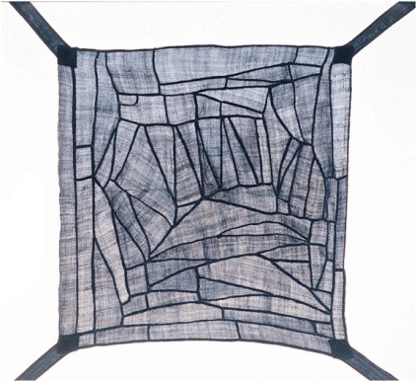
1. KOREA BOJAGI FORUM(KBF) – Six Paju Heyri Artists’ Village Galleries
> 2012 KBF Exhibition
□ Solo Exhibition
○ Nonbat Art School_Bat Gallery - Nancy Crasco, USA - Nina Bondeson, Sweden
○ Nonbat Art School_Non Gallery - Fiona Kirkwood, South Africa Performance
○ Gallery MOA – Kyungae Wang Solo ○ Art Space With Artist – Heesoon Yu Bojagi Collection
□ Group Exhibition_International Bojagi group works of artists from 10s countries including
US and Europe
○ Art Factory- 2012 KBF Bojagi & Beyond Korea.US.Europe RISD Bojagi Exhibition
○ Lee&Park Gallery- Korea/USA 'Seoul Inspiration', Quilt. Bojagi Exhibition
○ Art Space With Artist- Korean Paper Artist Association ‘Paper Bojagi’ Group Exhibition
○ Porcelain House Gallery - Bojagi International Art Costume Exhibition Invitation Exhibition
Participating artist 김수정/ 김영순/ 김영순/ 김영자/ 김옥현/ 김인자/ 김지희/ 김태연/ 김혜영/ 김혜자/ 나정희/ 노진영/ 박경희/ 박영란/ 신지혜/ 오순희/ 오승아/ 오정은/ 우현리/ 유미강/ 이명숙/ 이복희/ 이성순/ 이소라/ 이은숙/ 이은실/ 이정아/ 이청실/ 임선양/ / 장혜홍/ 정경연/ 정예금/ 주 리/ 차영순/ 차지선/ 최인숙/ 한선주/ 함정숙/ 허인열 /유희순 Bojagi Collection/
US, Alice Hill/ Barbara Shapiro/ Dawn Zero Erickson/ Jill Ault/ Jinja Kim Woollard / Jiseon Lee Isbara / Judy Harmony/ Julie Shirek/ Leonie Castelino / Marla Hattabaugh/ Mary Ruth Smith/ Mikyung Lee/ Patricia Marlarcher/ Patti King/ Precious Love/ Paula Rath/ Ruth Marchese/ Sharon Lin/ Sunha Hwang/ WonJu Seo/ Yolanda Sanchez
RISD, Beverley Thomas/ Cherry Johnson/ ChungIm Kim/ Clara Hagen/ Elisabeth Wasserman/ Gerdur Gudmundsdottir/ Hanne Lukka/ Jeannette Jackson/ Judith Mundwiler/ Karin Kunori/ Kirsi Niinimäki/ Marianne Penberthy/ Marianne Radman/ Molly Bullick/ Nami Minaki/ Neola Mills/ Robi Szalay/ Ruth Hofstaetter/ Sarah Tucker/ Sigrid Bannier/ Silvia Bos/ Wendy Lugg/ Yvonne Sutter/ LynNixon/ 길태윤/김경숙/김유미/김정식/노은희/양상훈/양주현/오명희/유봉희/이일수/이효선/정영모/정지영/홍영진/황소정/김은주/ 김혜숙/ 박 영/ 윤필남/ 이정애/ 장미선/ 장흥숙/ 조보경/ 최은영/ 최혜열/ Alice Hill / Judith Harmony / Loraine Sample/ Sharon Richard/간문자/ 김정혜/ 김혜연/문순영/ 문연희/ 박선희/ 박현신/ 배천범/ 이경옥/ 이정희/ 이준화/ 정 현/ 황지연/ Bannier Filz/ Beatriz Schaaf-Glesser/ Catherine O'Leary/ Judilee Fitzhugh/ Karen Hampton/ Risa5Benson/ Prescious Lovell
ⓒ The Museum of Korean Embroidery, Donghwa Huh

Slide 8
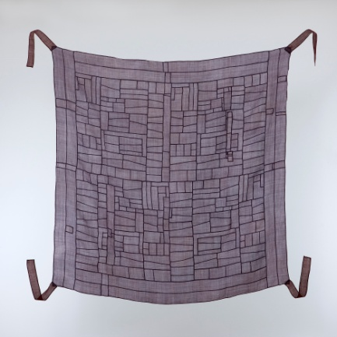
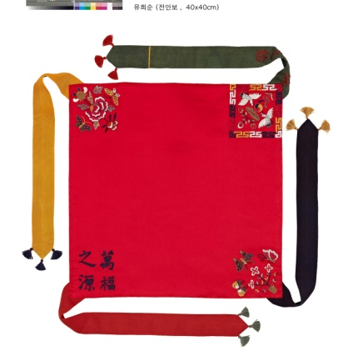
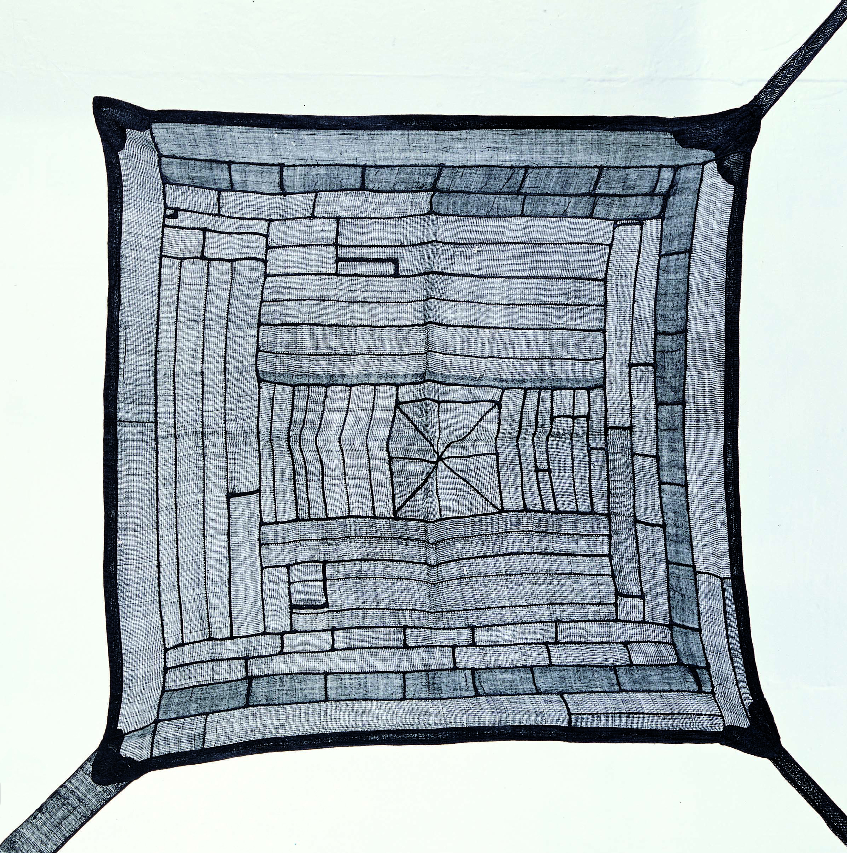
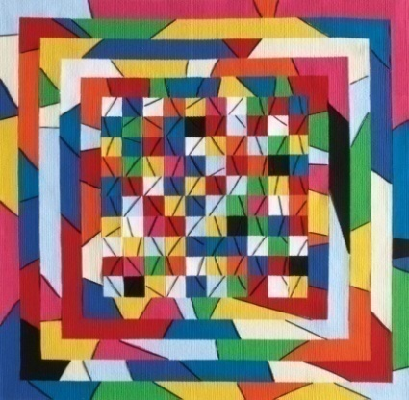
1. KOREA BOJAGI FORUM(KBF) – Six Paju Heyri Artists’ Village Galleries
> 2012 KBF Examples of Work Images
Director of Chojun Museum Embroidery Master Heesoon Yoo, Director of The Museum of Korean FAF Founder Jeongsuk Ham
Soonhee Kim, Embroidery Donghwa Huh,

Slide 9
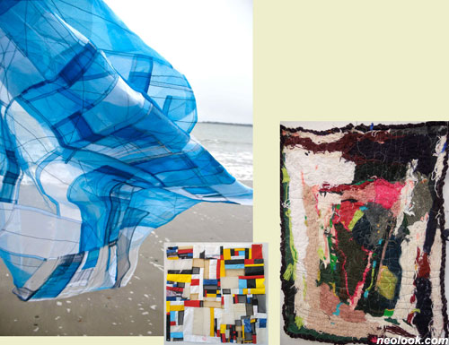
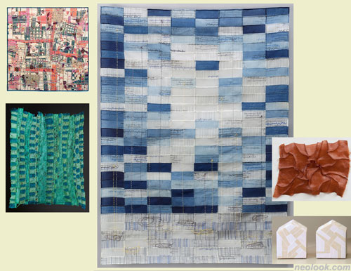
1. KOREA BOJAGI FORUM(KBF) – Six Paju Heyri Artists’ Village Galleries
> 2012 KBF Foreign Artists Work Images
ⓒ US RISD Bojagi & Beyond Group Bojagi Exhibition
Abigail Foster / Esther Hong / Sophia Heymans
ⓒ American Artist Bojagi Exhibition
MaryRuth Smith_AvalancheTwins / Julie Sirek_AnthopleuraJiseon Lee Isbara_Blue prints 2010 / Patricia Malarcher_Ruffle BojagiJinja Kim Woollard_Iceburg face

Slide 10
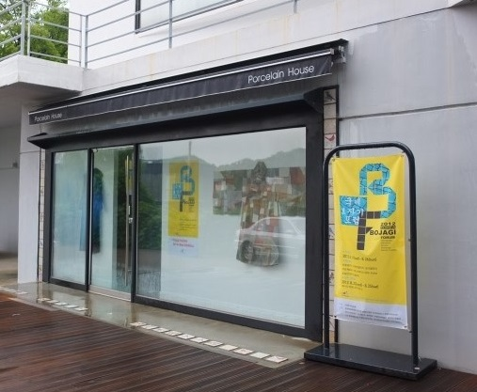
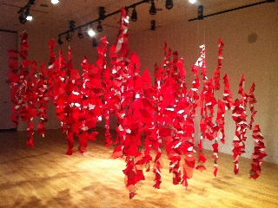
1. KOREA BOJAGI FORUM(KBF) – Six Paju Heyri Artists’ Village Galleries
> 2012 KBF Exhibition View
ⓒ Porcelain House Gallery View
Yeonhee Moon
ⓒ Porcelain House Gallery_SUNHA HWANG(USA)

Slide 11
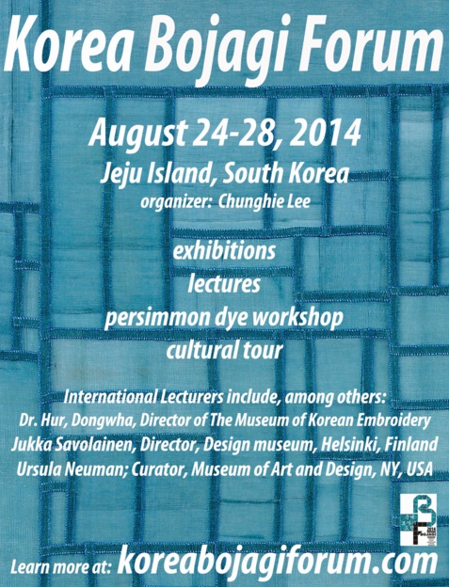
1. KOREA BOJAGI FORUM(KBF)
> 2014 KBF Overview – Six Jeju Jeoji Artists’ Village Galleries
Date : 2014 Aug 24(Sun) – Aug 28(Thu)
Location : Jeju Jeoji Artists’ Village
Exhibition : Kyudang Gallery, Gallery NORI, PAPA SITE,
Korean Calligraphy Gallery, The Gallery Hyun
Host : Korea Bojagi Forum
Sponsorship : Jeju Museum of Contemporary Art, Cheongju International Craft Biennale, The Museum of Korean Embroidery, Chojun Textile & Quilt Art Museum, Museum of Natural Dye Arts, Obangsaek, Chungheon Embroidery Studio, Fiber Art Fair(FAF), American Embassy in Seoul, Finnish Embassy in Seoul, YJM Entertainment, Rhode Island School of Design, Philadelphia University of Arts, Phnom Penh International Institute of Art, World Korea Trend Super Talent Competition

Slide 12
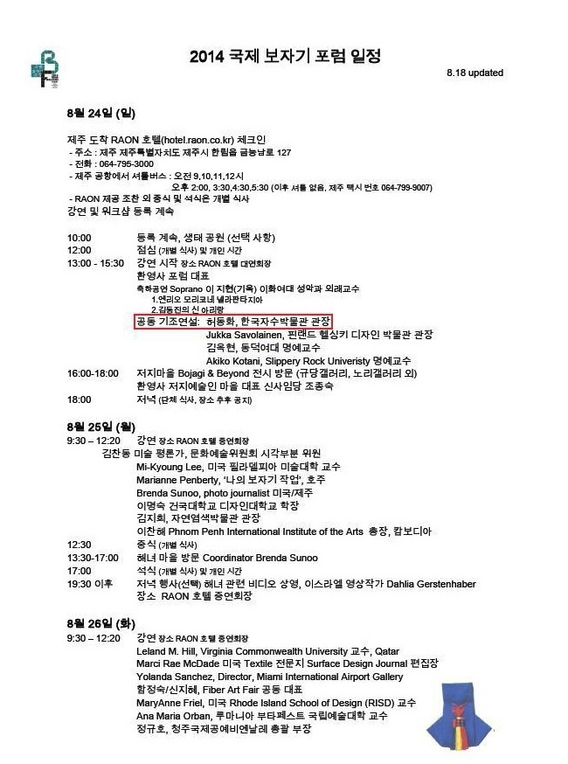
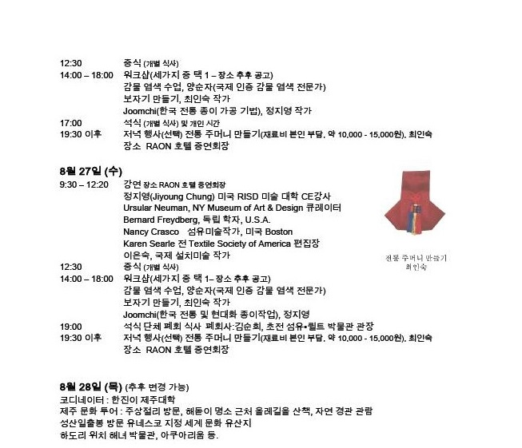
1. KOREA BOJAGI FORUM(KBF) – Six Jeju Jeoji Artists’ Village Galleries
> 2014 KBF Schedule

Slide 13
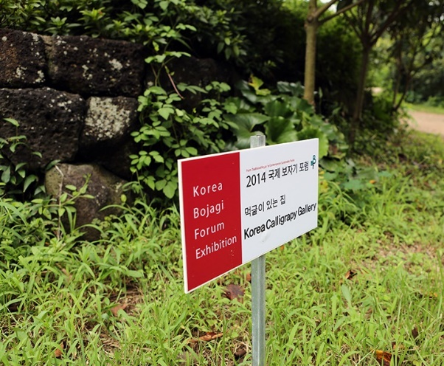
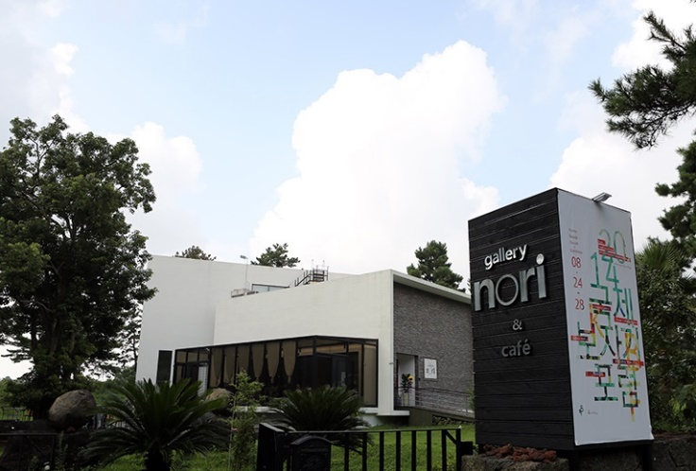
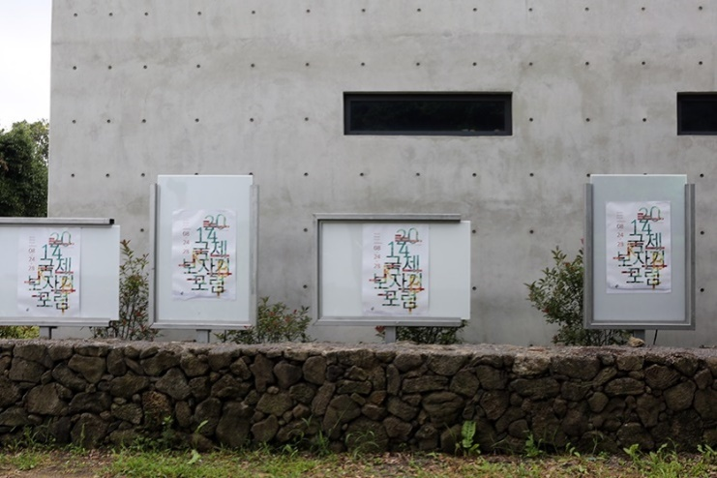
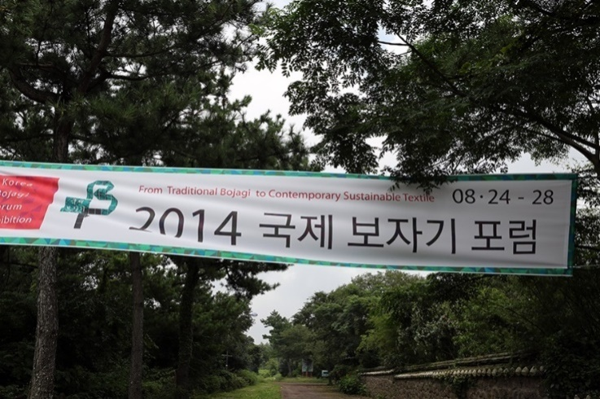
1. KOREA BOJAGI FORUM(KBF) – Six Jeju Jeoji Artists’ Village Galleries
> 2014 KBF Exhibition View
ⓒ Gallery NORI
ⓒ The Gallery Hyun View

Slide 14
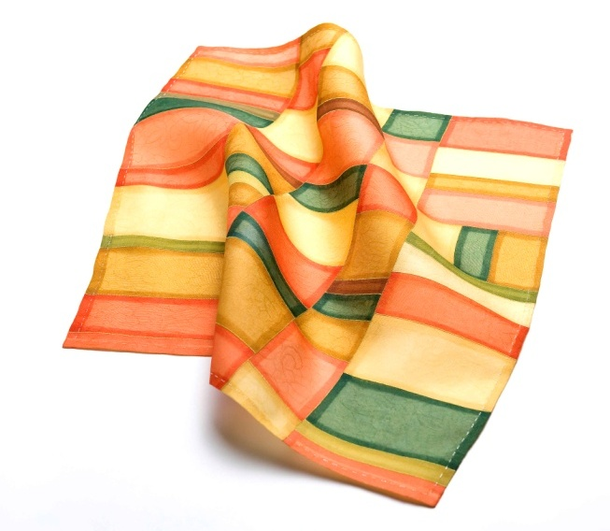
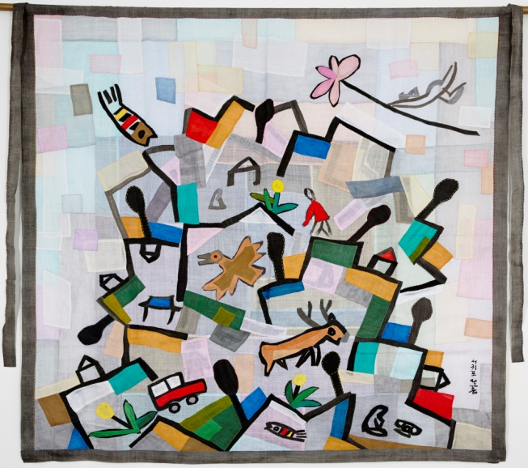
1. KOREA BOJAGI FORUM(KBF) – Six Jeju Jeoji Artists’ Village Galleries
> 2014 KBF Work Images
ⓒ Jaeeun Kim,
먹 글이 있는 집 전시전경
Kyeongyeon Jeong_ Oulim Harmony Installation_Dyeing, Patchwork
ⓒ 제주소재 왈종미술관 관장 이왈종 보자기

Slide 15
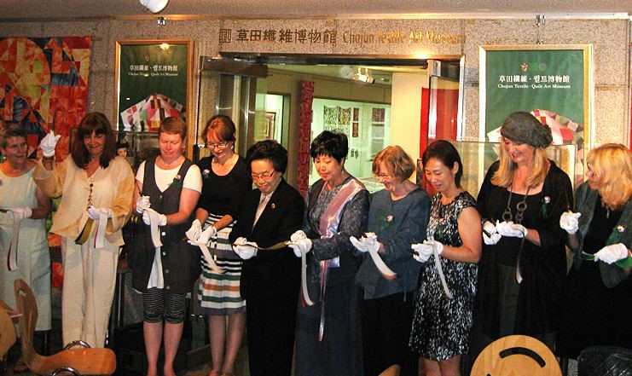
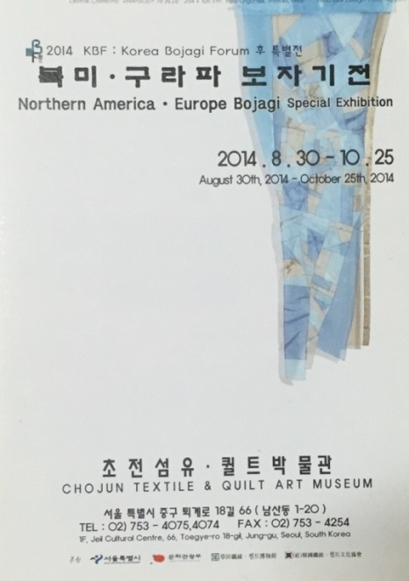
1. KOREA BOJAGI FORUM(KBF) - 2014 Gumi Bojagi Artists Special Exhibition
Linked Events After 2014 KBF_2014 Gumi Bojagi Artists Special Exhibition Seoul Chojun Textile & Quilt Museum, 2014.8.30-10.25 서울 중구 퇴계로18길 66 제일빌딩, 02-753-4075
ⓒ Printed_Leaflet
ⓒ Opening Ceremony
From left, 2014 KBF Moderator (Hawai textile artist Victoria Gail-White), US Textile Surface Design Journal Chief Editor (Qutar Marci Rae McDade), Yongin University Professor (Natalie St.Martin), Chojun Museum Director (Soonhee Kim), KBF Advisor Mokwon University Honorary professor (Youngsoon Kim), US Textile Society of America Chief Editor (Karen Searle), US Bojagi Artist (Youngmin Lee), Polish/US paper Artist (Ania Gilmore) etc.

Slide 16
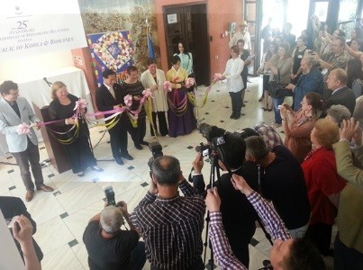
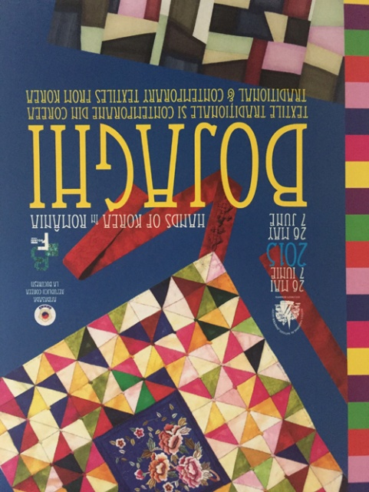
1. KOREA BOJAGI FORUM(KBF) -
2015 Korea/Romania 25th Anniversary of Diplomatic Relations Special Exhibition
Linked Events After 2014 KBF_2015 Korea/Romania 25th Anniversary of Diplomatic Relations Special Exhibition
The National Village Museum / 28-30, Șoseaua Pavel
Dimitrievici Kiseleff, București 011347 Romania
ⓒ Printed_Leaflet
ⓒ Opening Ceremony (Center : HyoSung Park, Ambassador of Romania,
Curator : Chunghie Lee, Dr. Anna Orban-Maria-Romania National University of Arts Professor)

Slide 17
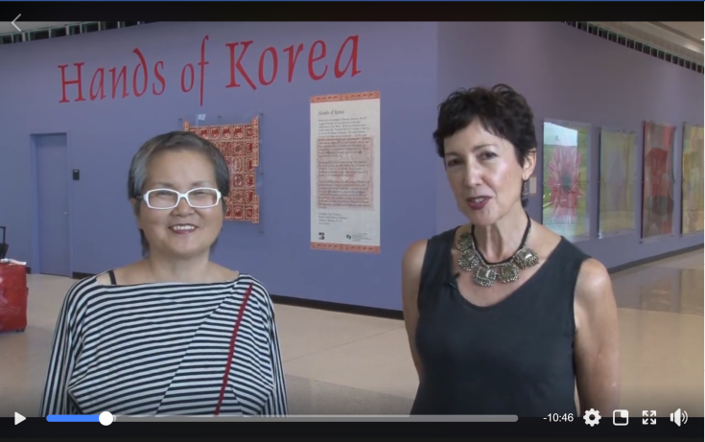
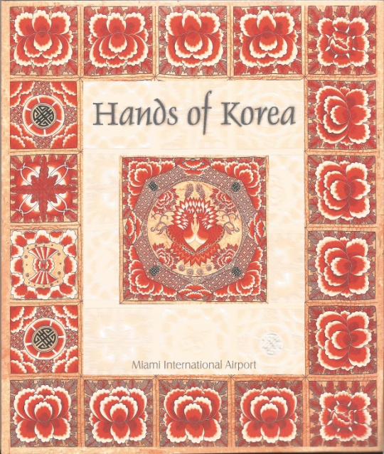
1. KOREA BOJAGI FORUM(KBF) - 2015 Hands of Korea-Miami
> Linked Events After 2014 KBF_2015 Hands of Korea-Miami
US Miami Airport Handmade Gallery /
2100 NW 42nd Ave, Miami, FL 33126 US
Curator : Chunghie Lee-KBF representative, Dr. Yolanda Sanchez-MIA Director)
ⓒ Printed_Leaflet
ⓒ https://www.facebook.com/beyondbojagi/videos/958142597588253/

Slide 18
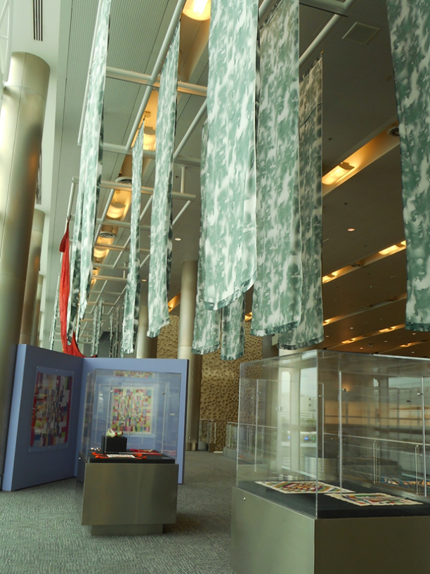
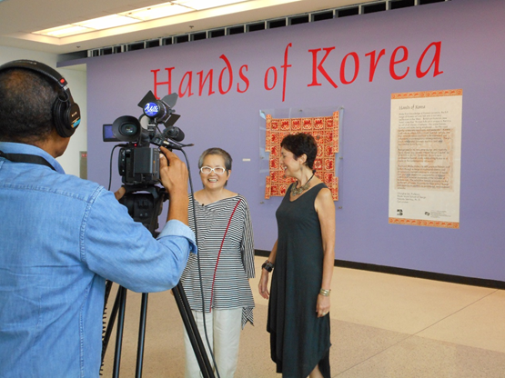
ⓒ After 2014 KBF, Linked Exhibition_
US Miami Airport Handmade Gallery
2015 Hands of Korea-Miami
Co-curator Chunghie Lee and Dr. Yolanda Sanchez
Total 30 Works
ⓒ Exhibition View, Modern interpretation of Bojagi installation (Hyehong Jang) and tradition-oriented works exhibited in the showcase

Slide 19
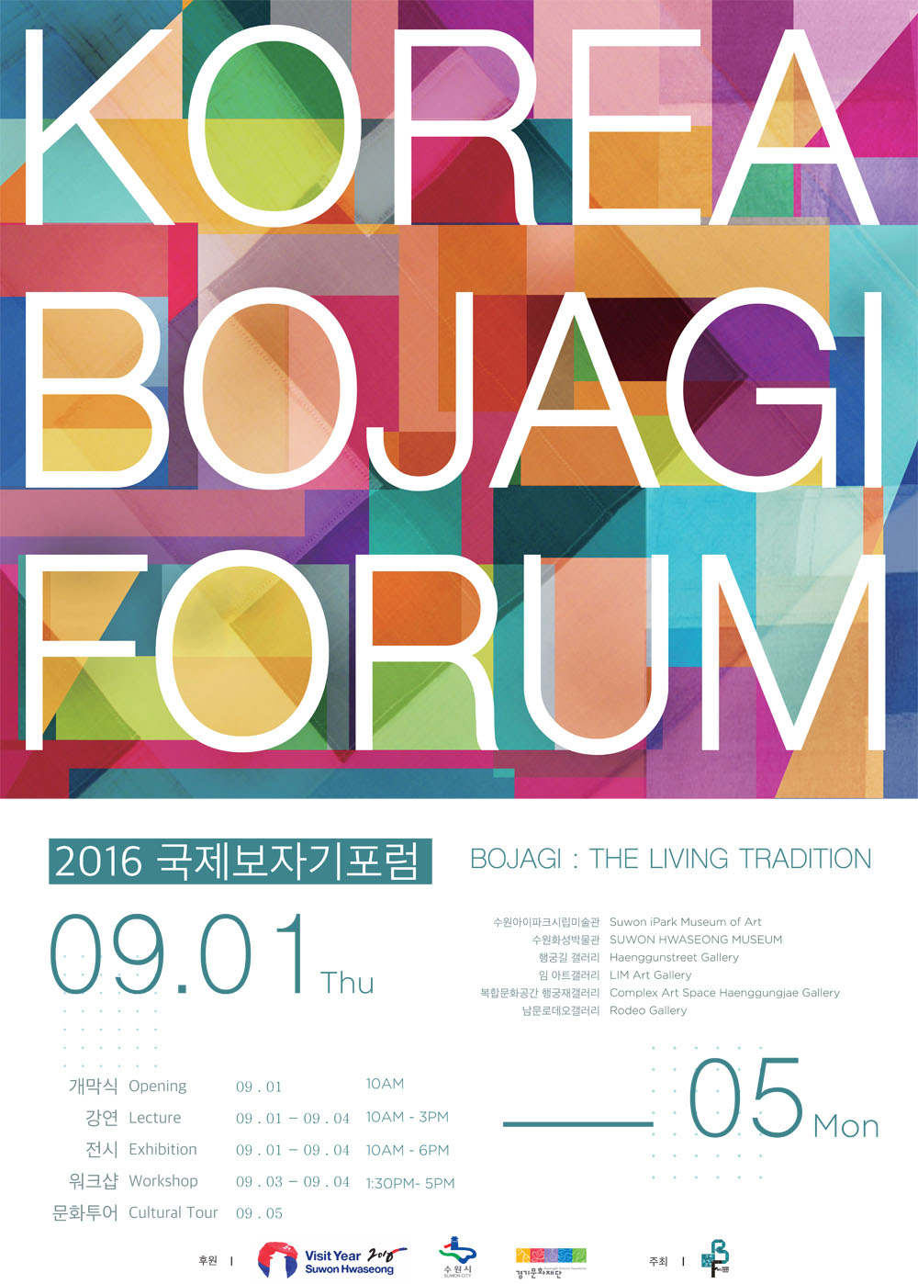
2. 2016 KBF – Suwon IPark Museum of Art and Five Galleries
> Overview
Date : 2016 09.01(Thu) – 09.05(Mon)
Lecture : 09.01(Thu) – 09.04(Sun), Suwon IPark Museum of Art
Workshop : 09.02-03일(Two Days), Suwon Hwaseong Haenggun
Exhibition : 09.01(Thu)-09.04(Sun), Suwon IPark Museum of Art,
Suwon Haeseong Museum, Haenggunstreet Gallery,
Complex Art Space Haenggungjae Gallery, LIM Art Gallery,
Rodeo Gallery more than five places
Culture Tour : 09.05(Mon)-09.07(Wed)
Location : Suwon Hwaseong Haenggun (Suwon IPark Museum of Art and others)
Contents : Lectures and exhibition workshops held by domestic and international scholars, professors, and artists on the subject of Bojagi
Host : KOREA BOJAGI FORUM
Sponsorship : Suwon City(Support Business)
GGCF, FAF, Museum of Textiles, 5 ART Magazine, Korean Quaterly Magazine, Korean Art Society in New York
※ This Project is supported by Suwon City.
.

Slide 20
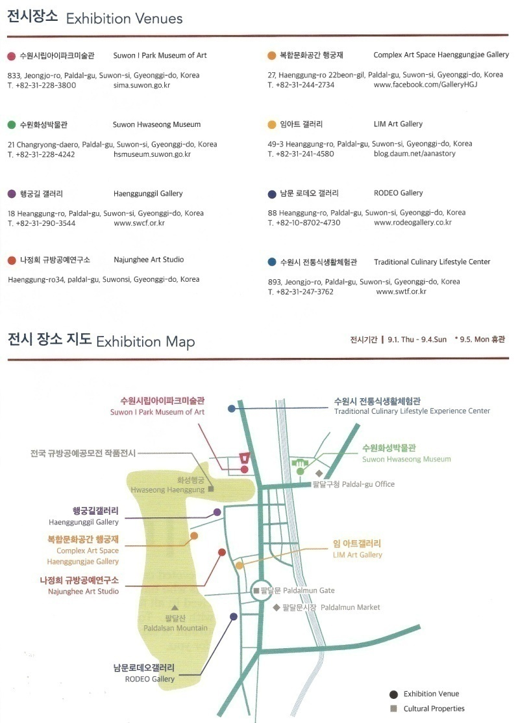
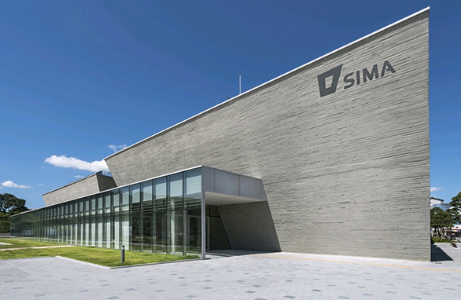
2. 2016 KBF
장소 : Suwon IPark Museum of Art and Five Galleries, 경기도 수원시 팔달구 신풍동 354-1, 031-228-3800
ⓒ Suwon IPark Museum of Art View

Slide 21
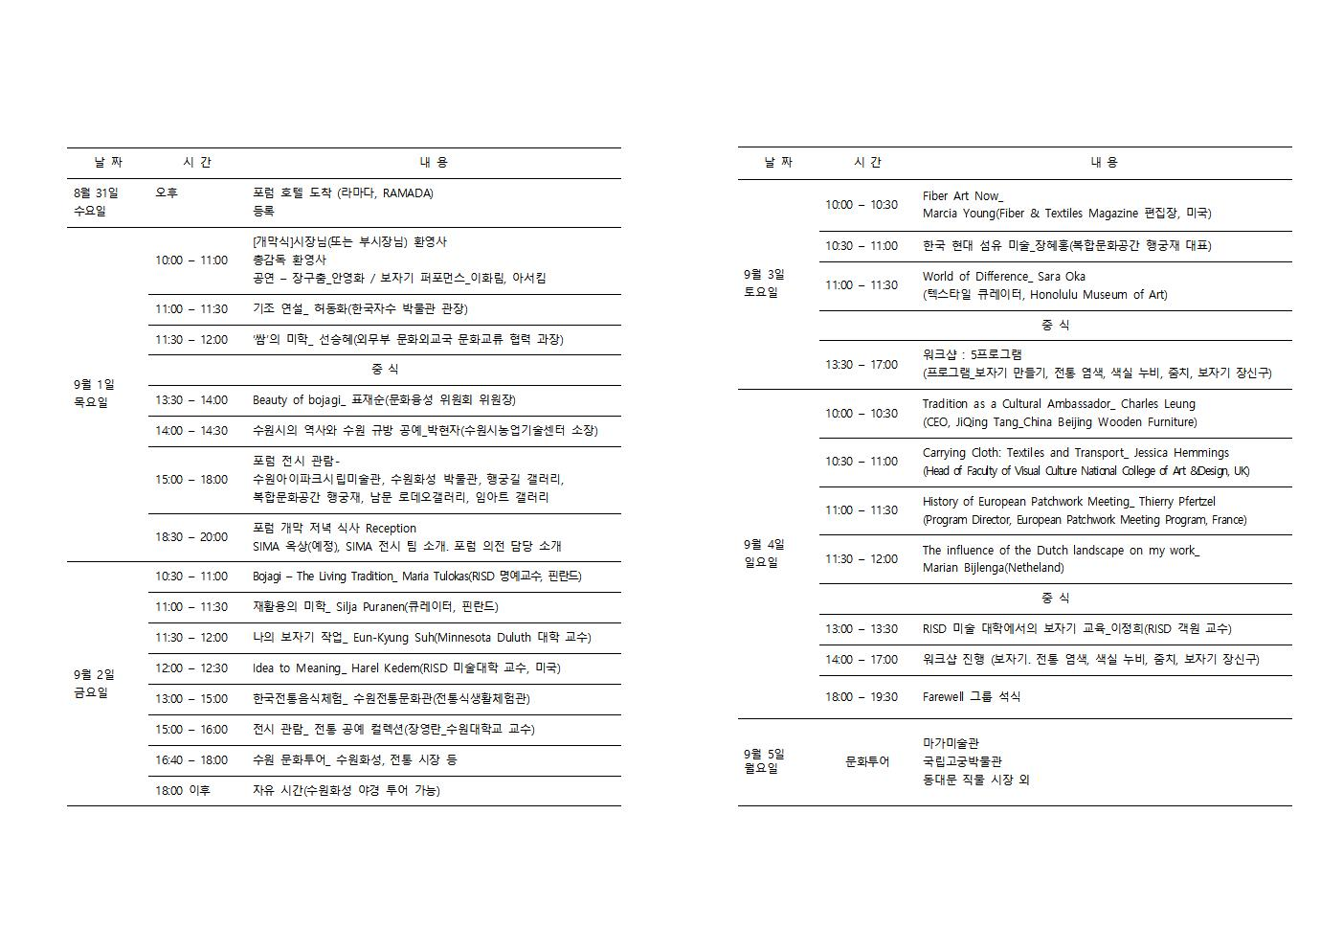
2. 2016 KBF – Suwon IPark Museum of Art and Five Galleries
> Lecture Topics and Speakers

Slide 22
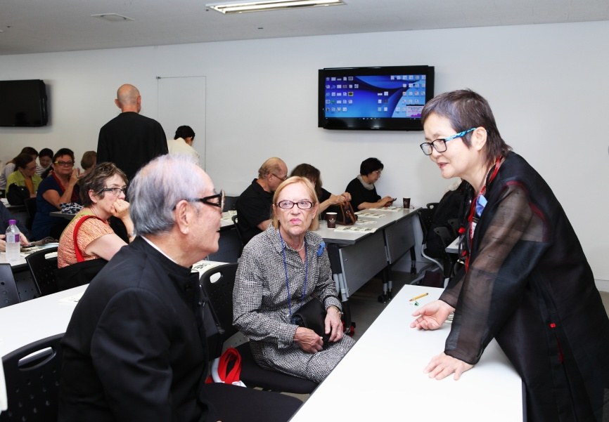
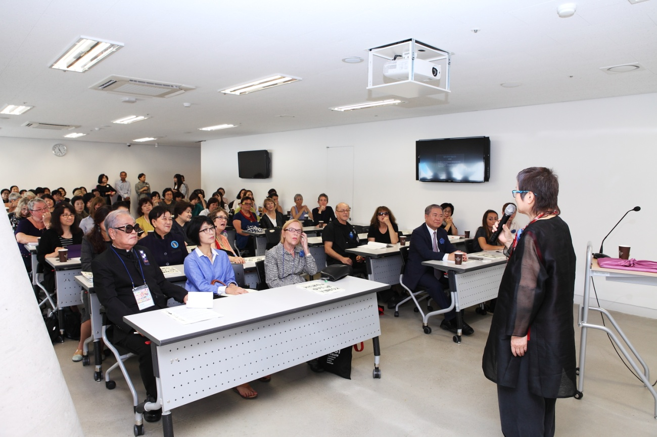
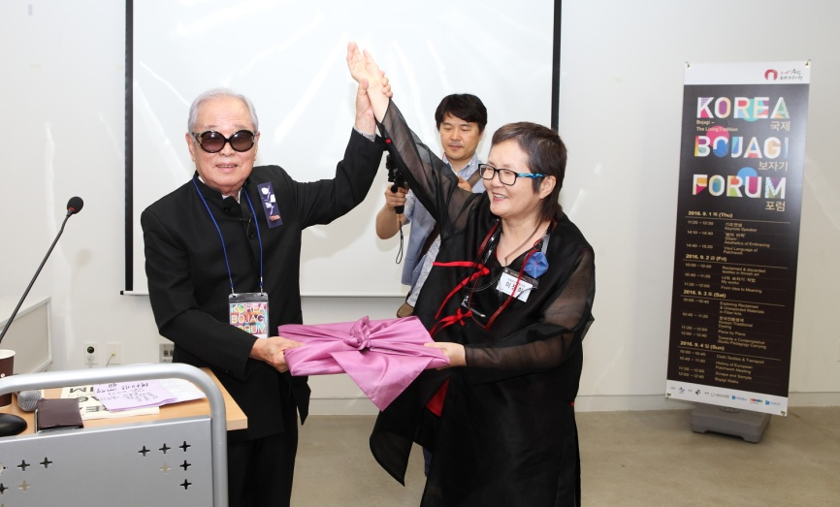
2. 2016 KBF – Suwon IPark Museum of Art and Five Galleries
> Lecture Photo
ⓒ 한국자수박물관 허동화 관장님의 축사, 계원예술대학 권영걸 총장님의 기조연설

Slide 23
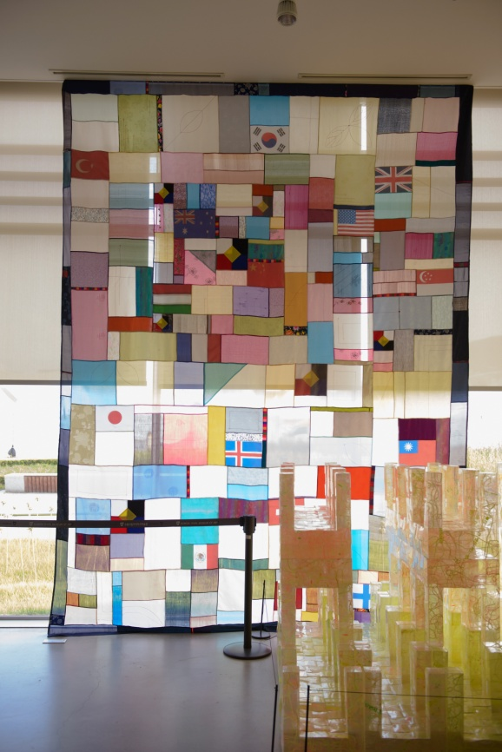
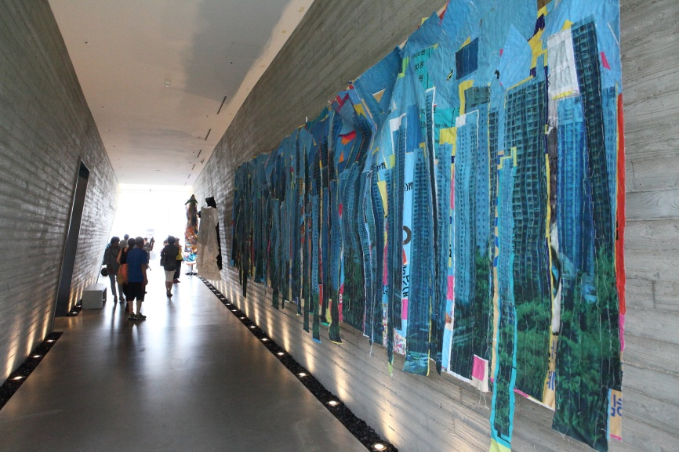
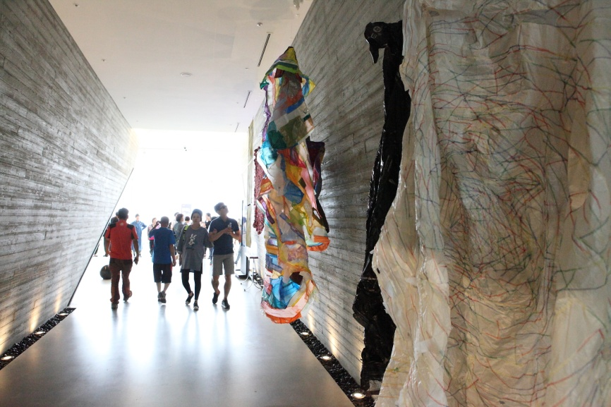
2. 2016 KBF – Suwon IPark Museum of Art and Five Galleries
> Exhibition Representative Images
ⓒ Suwon Gyubang Craft Group Work
ⓒ Exhibition View

Slide 24
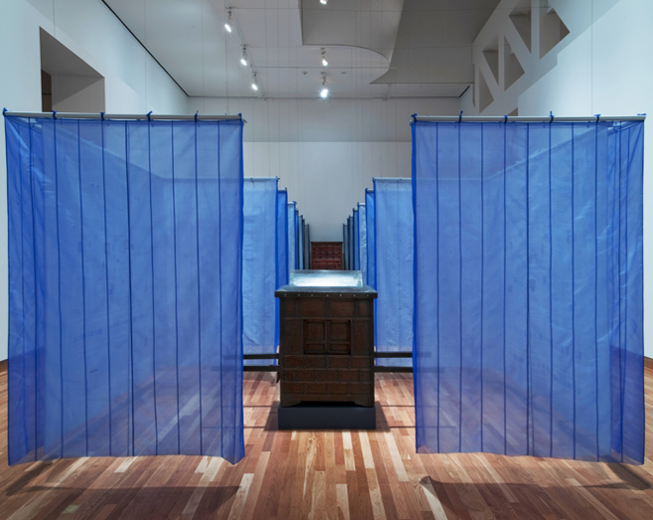
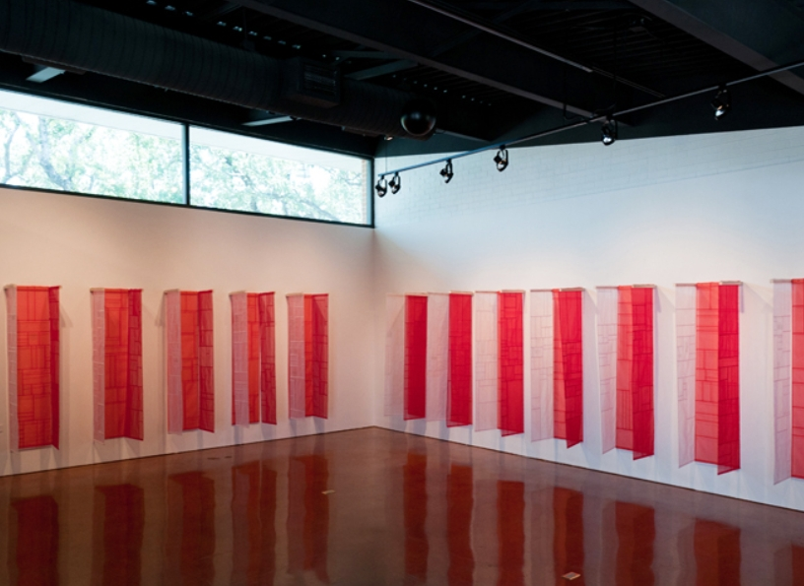
2. 2016 KBF – Suwon IPark Museum of Art and Five Galleries
Exhibition Venue – Suwon Hwaseong Museum
(경기 수원시 팔달구 창룡대로 21 수원화성박물관)
_Solo Exhibition : Eunkyeong Seo(USA, Professor University of Minnesota / Duluth
Minneapolis, MN. 55455 US)
Websites http://www.d.umn.edu/~esuh/01textile/045.html

Slide 25
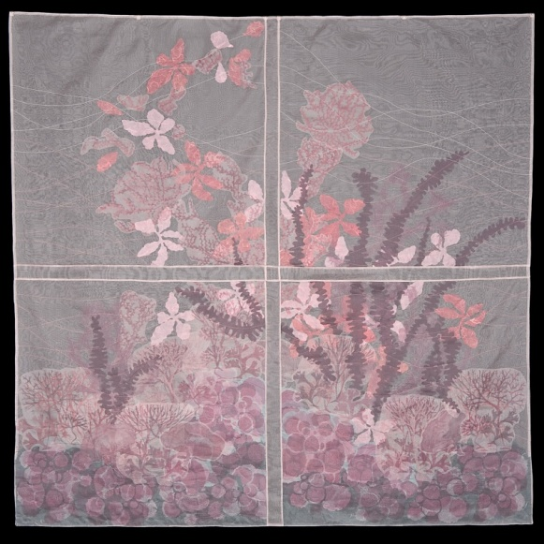
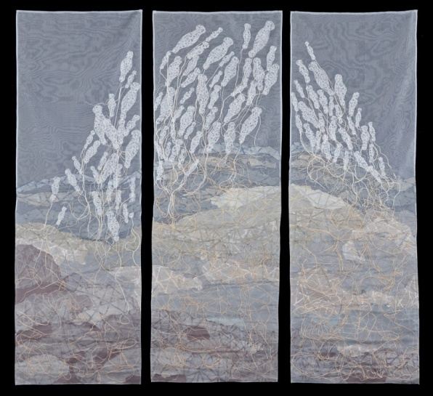
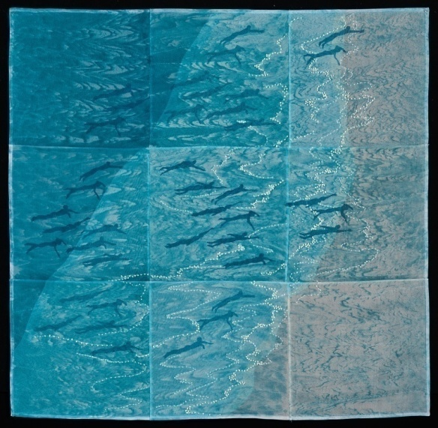
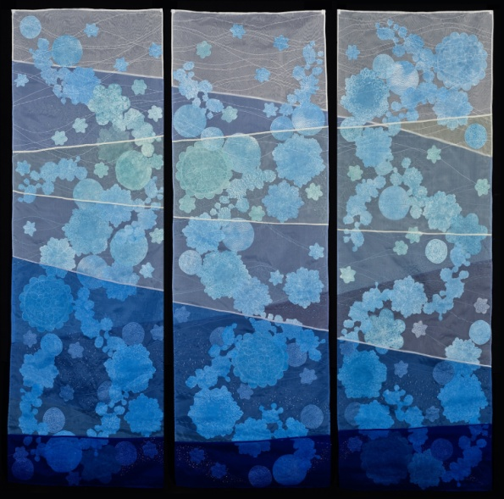
2. 2016 KBF
Exhibition Venue _ Suwon IPark Museum of Art (경기도 수원시 팔달구 신풍동 354-1)
Solo Exhibition
: Nancy Crasco
(Brighton, MA,
United States)
Websites
http://www.nancycrasco.com
▶ US Representative Artist
Nancy Crasco’s works

Slide 26
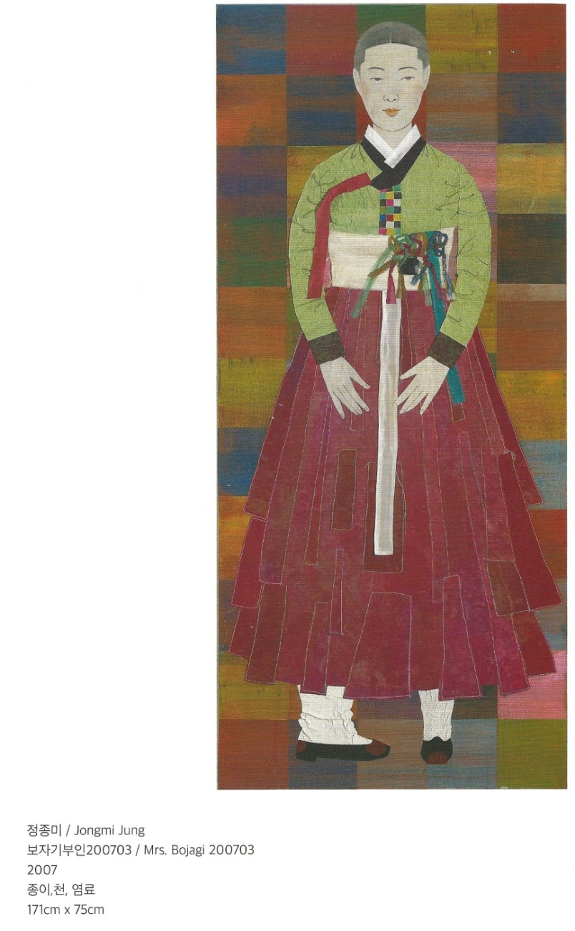
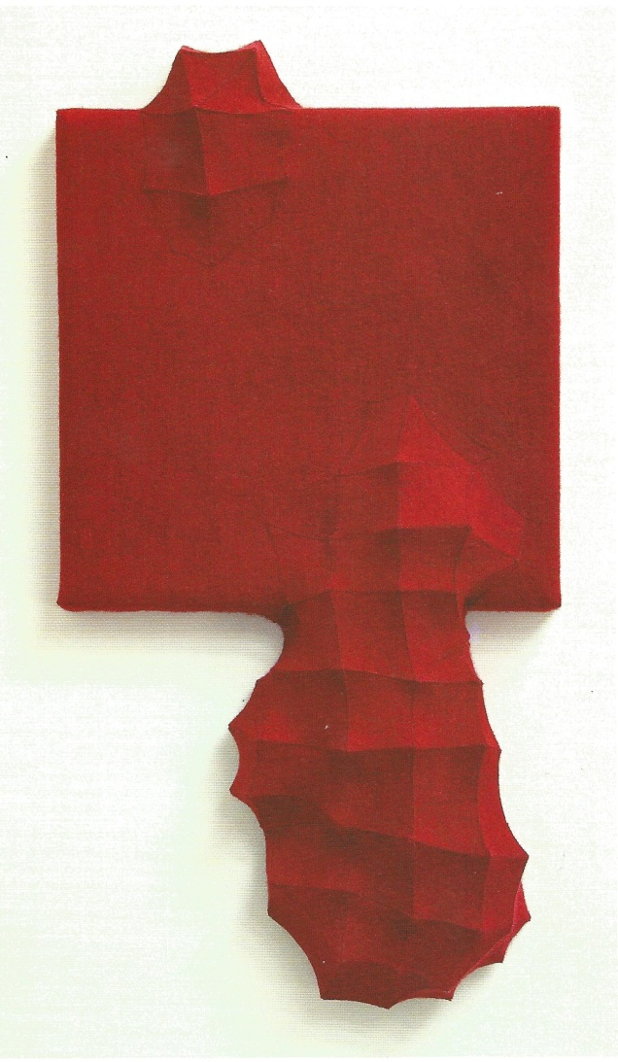
2. 2016 KBF – Suwon IPark Museum of Art and Five Galleries
> Exhibition_Artists : Jongmi Jung(Korea University Professor), Chung-Im Kim(Canada University of Ontario Professor)
Chung-Im Kim (Canada)
Mutation 3 / 변신 3
2015
Industrial felt, threads
60 x 31 x 8cm

Slide 27
2. 2016 KBF – Suwon IPark Museum of Art and Five Galleries
Exhibition_Artists : Mary Ruth Smith(USA, Texas Waco, Baylor Art College Professor)
Kyoung-yeon Chung (Hongik University Professor)
Websits https://www.lindagass.com/IntimateApparel/Artists/MaryRuthSmith.html

Slide 28
2. 2016 KBF - Suwon IPark Museum of Art and Five Galleries
Exhibition_Artists : (Left) Insuk Choi (Ulsan Bangudaepetroglyph Bojagi Master),
(Right) Marian Bijlenga(Netheland)
Multiple international judges participated
Websites http://marianbijlenga.tumblr.com/

Slide 29
2. 2016 KBF - Suwon IPark Museum of Art and Five Galleries
> Exhibition_Artists : (Left) Dorothy Caldwell (Canada), (Right) Alice Kettle(UK)
Websites http://dorothycaldwell.com/
Websites http://alicekettle.com/

Slide 30
2. 2016 KBF – Suwon IPark Museum of Art and Five Galleries
> Exhibition_Artists (Foreign Artists, Europe etc.)
▲ Silja Puranen – Finland
Clara Hagen- Switzerland ◀
Beatriz Schaaf-Giesser, Germany ◀
▲ Catherine OLeary, Australia

Slide 31
2. 2016 KBF - Suwon IPark Museum of Art and Five Galleries
> ‘Bojagi’ Archive and Exhibition for Globalization of Korean Cultural Brands _ Sponsored by Gyeonggi Cultural Foundation
ⓒ Sponsored by GGCF Bojagi Research Book
(Chunghie Lee, 40 years of research)
ⓒ Exhibition View
MFA(The Museum of Finnish Architecture), Helsinki, Finland
As part of the exhibition on KBF, I want to archive the 12 years (1999-2017) research data from Rhode Island School of Design, RISD. Also, I proceed archive exhibition focusing on experimental and creative Bojagi works of students with various major, ages, and nationalities. I expect this place will make Bojagi as Korean culture brand in the world.
Instructor:Chunghie Lee
※ This Project is supported by Gyeonggi Cultural Foundation.

Slide 32
2. 2016 KBF - Suwon IPark Museum of Art and Five Galleries
> Workshop_Programs and Instructors

Slide 33
2. 2016 KBF - Suwon IPark Museum of Art and Five Galleries
> Workshop_Program (Location: Najunghie Art Studio)
Traditional Bojagi Making : Obangsaek Bojagi
(Instructor Junghie Na, Najunghee Art Studio Representative, njh0120@naver.com )
Contents :
Blue, White, Red, Black, Yellow Obangsaek (five colors) is Korean traditional colors that symbolizes the defense of north, south, east and west.
Blue is fortune and desire,
White is eternity good luck,
Red is long life,
Black contains the meaning of the mind of wish-fulfillment and away from evils
By making an Obangsaek Bojagi with symbolism, experience color of Korean style and unique Korean emotion.

Slide 34
2. 2016 KBF - Suwon IPark Museum of Art and Five Galleries
> Workshop_Program (Location: Suwon Haenggunjae)
2. Tradiutional dye(Instructor : Haehong Chang, Haenggunjae Representative, hhchang99@daum.net)
Contents :
Day 1 : Yellow, Jade Green, 유록색 etc. dyeing three color scarf
Day 2 : Red, Purple, Yellow, 유록색 dyeing fabric
Korea's textile culture has formed a unique and beautiful culture in the mid-point of Northeast Asia that has been connecting China and Japan since ancient times.
The traditional color of Korea is symbolized by 五方正色(five colors) based on oriental Yin-Yang School. It has a symbolic significance in expressing the national identity embodied in Korean textile arts as an international art method.
When we reproduce the colors according to the traditional dyeing method expressed in the Korean ancient books and express the oriental thoughts contained in them in contemporary art, we seek to find a union point of human emotion in the East and the West

Slide 35
2. 2016 KBF - Suwon IPark Museum of Art and Five Galleries
> Workshop_Program (Location: LIM Art Gallery)
3. Traditional Quilting and Jobawi(Instructor : Hyejin Lee, Jogakbo Story, 337lhj@gmail.com)
ⓒ Onyang Museum
ⓒ Hyejin Lee Bojagi, Traditional Costume Works
Contents :
“Jobawi” was one of the women’s winter hat used at the end of the 19th century as a ceremonial costume. Now, baby girls wear a gold foil jobawi with hanbok for first-birthday party. “Traditional Quilting” is a technique of gyubang craft which puts a string between two pieces of fabric and stitches it into dyed threads to decorate the fabric with a geometric pattern. By making jobawi decorated with traditional quilting, You can experience the universality and specialty of East and West sewing culture.

Slide 36
2. 2016 KBF - Suwon IPark Museum of Art and Five Galleries
> Workshop_Program (Location: Suwon IPark Museum of Art Lecture Room)
4. Joomchi (Instructor : Sanghoon Yang, Duksung Women's University Visiting Professor,
Korean Paper Molding Artist Association Chairman, blog.naver.com/asdysh2263)
Contents :
Joomchi is the process of handmade paper with a traditional Korean textured feel, it uses layers of paper made of mulberry leaves and water.
In this workshop, we will introduce a Joomchi process that allows you to practice the rules of hand-made paper.

Slide 37
2. 2016 KBF - Suwon IPark Museum of Art and Five Galleries
> Workshop_Program (Location: Suwon Haenggungjae)
5. Making Bojagi Ornament _Bojagi Cuffs & Mini Sculptural Bojagi
(Instructor : Wonju Seo, Bojagi Artist New Jersey, US
Happyday200211@yahoo.com)
Contents :
Using Korean traditional silk fabrics, threads, and various materials, you can learn Korean traditional hand sewing by making various bojagi structures that can be used as cuffs, brooches, ornaments, or decoration.
Participants can apply a bojagi pattern by creating their own unique and colorful design.

Slide 38
2. 2016 KBF - Suwon IPark Museum of Art and Five Galleries
> Program Guide Leaflet

Slide 39
2. Linked Events After 2016 KBF- 2017 <Hands of Korea> Bojagi Exhibition
> Overview - EPM(European Patchwork Meeting) France
Date : 2017 09.14(Thu) – 09.17(Sun)
Location : Sainte Marie Aux Mines, France
Contents : The International Europe Patchwork Competition, which started in 1995 and largest in Europe (more than 30,000 spectators from 50 countries), holds quilting exhibitions, workshops, lectures, designer corners with fashion shows, various subsidiary materials related to quilt production, various education, and exhibition programs.
Host : KOREA BOJAGI FORUM
Sponsorship : Arts Council Korea(Support Business)
※ This Project is supported by the Arts Council Korea.

Slide 40
2. 2017 <Hands of Korea> Bojagi Exhibition Linked Event
EPM(European Patchwork Meeting) – Sainte-Marie-aux-Mines, France
http://www.patchwork-europe.com/
Korea was invited as a guest-country of honor at 2017 European Patchwork meeting held in Sainte-Marie-aux-Mines, France from September 14th to 17th, 2017, and this was an opportunity to show our cultural status. Korean artists participating in this exhibition, Mayor of Sainte-Marie-aux-Mines(Claude Abel:middle), and 2017 HOK coordinator Elisabeth Wassarmann(Switzerland, Mayor’s left)
Invitation from Mayor of Sainte-Marie-aux-Mines

Slide 41
3. 2018 KBF – Part 1 Seoul Trade Exhibition & Convention (SETEC) Hall No.3
> Overview
Date : Part 1 _ 2018 05.31(Thu) – 06.03(Sun)
Part 2 _ 2018 09.07(Fri) – 10.08(Mon)
Lecture : 06.01(Fri), SETEC Conference Room
Workshop : 05.30(Web), Ewha Women’s University Textile Art Department Building A-402
Exhibition : 05.31(Thu)-06.03(Sun), SETEC
(SETEC) Culture Tour : 06.04(Mon), 06.06일(Web) – Jongmyo, Dongdaemun Textile Market, The National Folk Museum of Korea, Insadong, Ulsan
Contents : Lectures and exhibitions of overseas artists on the
theme of bojagi, and one day bojagi making workshop
Host : KOREA BOJAGI FORUM
Sponsorship : Arts Council Korea(Support Business)
Hanokmagazine, Chojun Textile & Quilt Art Museum, Traditional Patchwork Studio, FAF, Chungheon, Haenggungjae, 김경희의 쿠킹스쿨, Najunghee Art Studio, Mokwon University, Pagoda Hanji Industry, 가야캘리영근, Textile Art, Ewha University, PRISM
※ This Project is supported by the Arts Council Korea.

Slide 42
3. 2018 KBF
Location : Part 1 _ The World’s Bojagi Coming to Seoul
SETEC – Hall No. 3 Art&Craft (Seoul Trade Exhibition & Convention)
Part 2 _ Korean Bojagi Going to New York
The Clemente, (107 Suffolk Street, New York, 10002)
+1 (212) 260-4080, info@theclementecenter.org, http://www.theclementecenter.org/
ⓒ SETEC
ⓒ The Clemente

Slide 43
3. 2018 KBF – Part 1 Seoul Trade Exhibition & Convention (SETEC) Hall No.3
Exhibition - Invitation Solo Exhibition (USA/Finland/UK/Netherlands/Japan/France 6 Artists)
ⓒ Leonie Castelino (U.S.A.)
ⓒ Sara cook (U.K.)
ⓒ Raija Jokinen (Finland)
ⓒ Marielle Huijsman (Netherlands)
ⓒ Yoko Kubota_(Japan)
ⓒ Maryse Allard (France)

Slide 44
3. 2018 KBF – Part 1 Seoul Trade Exhibition & Convention (SETEC) Hall No.3
> Exhibition - Participating Artists
(Left) Astrid Kensinger(Singapore) - Nanyang Technological University Professor
(Right) Joanne Morgan(U.K.) - painter
▶
▶
Websites http:// www.JoanneMorganarts.com /

Slide 45
3. 2018 KBF – Part 1 Seoul Trade Exhibition & Convention (SETEC) Hall No.3
> Exhibition - Participating Artists
Leslie Nobler(US) – New Jersey, USA William Paterson University Professor
Moon-he Baik(US) - Associate Professor, LEED AP, Program Head, Interior Design, University of Louisville
▲
▶
Owned at the Chojun Textile & Quilt Art Museum

Slide 46
3. 2018 KBF – Part 1 Seoul Trade Exhibition & Convention (SETEC) Hall No.3
> Exhibition - Participating Artists
: Marian Bijlenga(Netheland) / Hannah Sandstrom Brunskog(Sweden)
▶
▶
Websites www.hannahsandstrom.se
www.instagram.com/hannahappenings
Many participation of international event judges
Websites http://marianbijlenga.tumblr.com/

Slide 47
3. 2018 KBF– Part 1 Seoul Trade Exhibition & Convention (SETEC) Hall No.3
> Exhibition - Participating Artists
: (Left) Magda Sobon(Poland) / (Right) Judith Mundwiler(Swiss)
▶
▶

Slide 48
3. 2018 KBF– Part 1 Seoul Trade Exhibition & Convention (SETEC) Hall No.3
> Exhibition_ Group Exhibition(US TSGNY, Switzerland, Romania, Yongin University)
▶ Representative Textile Group in US
TSGNY Group Exhibition Works
43 Artists, 45 Works

Slide 49
3. 2018 KBF – Part 1 Seoul Trade Exhibition & Convention (SETEC) Hall No.3
> Exhibition_ Group Exhibition(US TSGNY, Switzerland, Romania, Yongin University)
▶ SWISS Group Works
4 Artists
Elisabeth Wassermann
Catherine Lambert
Gabrielle Savioz
Maria Soukenik

Slide 50
3. 2018 KBF – Part 1 Seoul Trade Exhibition & Convention (SETEC) Hall No.3
> Exhibition_ Group Exhibition(US TSGNY, Switzerland, Romania, Yongin University)
National University of Arts Bucharest/Romania/Europe students
▶ Professor (Anna Orban-Maria, Phd.)and Romania students

Slide 51
3. 2018 KBF – Part 1 Seoul Trade Exhibition & Convention (SETEC) Hall No.3
> Exhibition_ Group Exhibition(US TSGNY, Switzerland, Romania, Yongin University)
Natalie St. Martin ▶
◀ Professor (Natalie St. Martin)
▼ 24 Yongin University
foreign students
▲ Yongin University foreign students group work

Slide 52
3. 2018 KBF (Location : Ehwa Women's University Textile Art Department Building A-402)
> Workshop_Programs and Instructor Introduction
NO. | Theme | Instructor | 소속 | Contact and Email
1 | One Day Bojagi Making | Kyunghee Kim | Ewha Women’s University Textile Arts Department Lecturer | tkhj3315@hanmail.net
One Day Bojagi Making (Instructor Kyunghee Kim)
Contents :
Bojagi master’s basic Korean bojagi making for foreign students
※ Workshop Process
10:00 – 12:00 (Learn Korean Traditional Quilting Techniques)
12:00 – 13:00 (Lunch: Ewha Women’s University ECC 케세이호) (ECC Tour and walk)
13:00 – 14:00 (Watch Bojagi ppt)
14:00 – 16:00 (Korean Traditional Bojagi Making)
Kyunghee Kim, Basic Bojagi

Slide 53
3. 2018 KBF (Location : Ehwa Women's University Textile Art Department Building A-402)
> Workshop_Poster

Slide 54
3. 2018 KBF (Location : Ehwa Women's University Textile Art Department Building A-402)
> Workshop _ Photos
ⓒ Workshop Scene
ⓒ Ehwa Women's University ECC (Ewha Campus Complex) Tour

Slide 55
3. 2018 KBF – Part 1 SETEC Conference Room
> Lecture_Program and Instructor Introduction
NO. | Theme | Instructor | 소속 | Contact and Email
1 | Korean Culture in the Bojagi, the Spirit | Chandong Kim | Art Critic, Former Arko Art Center Director | kcdong@hanmail.net
2 | A Dream in a Dream in a Dream on Wings | Leonie Castelino | U.S.A. | leoniecastelino@gmail.com
3 | Patchwork of my life | Sara Cook | United Kingdom | sara.cook3@ntlworld.com
4 | West Meets East | Marielle Huijsmans | Netherlands | marielle50@ziggo.nl
5 | Expression Thru Material | Raija Jokinen | Finland | raijoki@gmail.com
6 | Bojagi As My Artistic Medium | Yoko Kubota | Japan | fwip2847@nifty.com
7 | Beauty of Korea…Discovered by a French Woman | Maryse Allard Le Roux | France | maryseallard@gmail.com
Contents of lecture: Reinterpretation of Korean bojagi by 6 invited artists (USA, UK, France, Japan, Netherlands, Finland)

Slide 56
3. 2018 KBF – Part 1 SETEC Conference Room
> Lecture _ Poster

Slide 57
3. 2018 KBF – Part 1 SETEC Conference Room
> Lecture - Photos 2018.6.1
ⓒ Conference Room
ⓒ From top to bottom
Chandong Kim, Leonie Castelino, Sara Cook, Marielle Huijsmans, Raija Jokinen, Yoko Kubota, Maryse Allard Le Roux

Slide 58
3. 2018 KBF
Culture Tour_Programs & Guides Introduction
2018.06.04, 06.06
NO. | Location | Guided by | 소속 | Contact and Email
1 | Jongmyo, Dongdaemun Textile Market, Insadong, Kyungdong Market Traditional Medicinal Stores | Moon-he Baik | Associate Professor, LEED AP Program Head, Interior Design University of Louisville | moon-he.baik@louisville.edu
2 | Ulsan Bangudae Petroglyph | Insuk Choi | Bojagi Master, Korea Bojagi Forum Advisory Artist | ischoi0916@gmail.com
Contents : Exploration of Historical architecture showing the Korean culture Jongmyo and Dongdaemun Textile market.
An environmental project to preserve historic petroglyphs that could be submerged.

Slide 59
3. 2018 KBF
> Culture Tour _ Information

Slide 60
3. 2018 KBF
> Cultural Tours - Scene Photos
< Dongdaemun Plaza Market >
<Ulsan Bangudae Petroglyph Project>
Foreign artists’ preliminary survey for Bangudae Petroglyph Project.
Dalhee Lee Petroglyph Forum representative,
University of Ulsan, Economics Professor
Swedish artist Hannah Sandstrom and
Insuk Choi bojagi master preliminary survey

Slide 61
3. KBF Prints
[2012 Catalogue]
[2014 Catalogue]

Slide 62
3. KBF Prints
[2016 Catalogue]
[2018 Catalogue]

Slide 63
3. POST 2018 KBF Linked Event – Seoul Chojun Textile & Quilt Art Museum
> Overview
Date : 2018 06.05(Tue) – 07.31(Tue)
Location : Chojun Textile & Quilt Art Museum
서울 중구 퇴계로 18길 66 제일빌딩 1F
Website : http://www.jculture.co.kr
Contents : With the theme of Korean traditional gyubang craft, it shows that the bojagi is now spreading and being used in the world, beyond the limited locality that is only thing in Korea.
Host : Chojun Textile & Quilt Art Museum
Sponsorship : Seoul city subsidy support project
Seoul Metropolitan Government, The Korea Museum Association, Korea Bojagi Forum
※ This project is supported by Seoul city.

Slide 64
3. POST 2018 KBF Linked Event – Seoul Chojun Textile & Quilt Art Museum
> Exhibition _ Scene Photos
※ This project is supported by Seoul city.

Slide 65
3. POST 2018 KBF Linked Event – Seoul Chojun Textile & Quilt Art Museum
> Exhibition _ Scene Photos
◀ Netherlands Artist
Marielle Huijmans Solo
◀ US Artist
Leonie Castelino Solo
▲ US Textile Study Group New York TSGNY
※ This project is supported by Seoul city.

Slide 66
3. 2018 KBF
> Accomplishment
• Globalization of bojagi culture/promote the status of Korean textile art and Korean culture through direct visit to Korea by foreign artists.
Internationally initiated cultural awareness about the Ulsan peninsula petroglyph in the buried crisis (Established the USA/Sweden/Finland/Korea artist group to continue the Bangudae Petroglyph Project)
Promoting the excellence of Korean culture through international exchange projects
_ Exhibition Convention Sweden Artist Hannah Sandstrom Brunskog
(snotrasynar@gmail.com) at Suwon Haenggungjae
Ilhan Kim(hanpakim@naver.com) and Magenta Kang
(gangks@hotmail.com) duo exhibition at Old School Gallery,
Cambridge, UK (2018 07.07~07.29), and booth exhibition at ‘The
Festival of Quilts 2018- Birmingham Competition’
(2018 08.09~08.12)
The international festival will be held for domestic and foreign tourists with the opportunity to present professional and a wide variety of bojagi lectures and exhibitions. - Contributing to the expansion of the bojagi population around the world
ⓒ Sweden Artist Hannah Sandstrom Brunskog’s solo exhibition poster

Slide 67
3. 2018 KBF
> Accomplishment
• Finland Artist Raija Jokinen(raijoki@gmail.com) and Hyehong Chang (hhchang99@daum.net), Hyesook Kim(invisible57@naver.com) selected as the solo exhibition booth artists at the Fiber Art Fair(FAF) in the Seoul Arts Center June, 2019.
FAF Director : Jungsook Ham(0174202240@hanmail.net)
2018 06.05 Agreed to each other at the Chojun Textile & Quilt Art Museum
• Begin to discuss the exhibition of the Korea Bojagi Forum at the University and Museum in the United States for Korea Bojagi Forum in 2020
(Chunghie Lee_ chunghielee.kbf@gmail.com / Kyungyeon Chung_owon55@hanmail.net / Moon-he Baik_moon-he.baik@louisville.edu, Moonhe Baik, Associate Professor, LEED AP Program Head, Interior Design University of Louisville / Seung-kyung Kim_sk84@indiana.edu, Seung-kyung Kim, Director, Institute for Korean Studies Indiana University)
* 6/7 Insadong 선천 Meeting
2020 Forum Exhibition Expected Places
Indiana University, Bloomington, Indiana Eskenazi Art Museum, Grunwald Art Gallery
University of Louisville, Cressman Gallery, Covi Gallery
Louisville, Speed Art Museum, Kentucky Arts and Crafts Museum, Asian Institute, Crane House
Poland LODZ TEXTILE MUSEUM 섭외중 (Coordinator : Ania Gilmore)
ⓒ 2018 KBF Invited Artist (Finland)Raija Jokinen 작품의 책표지 선정

